Slide 1
Networking Concepts – May 22
Agenda
Mod D.4 Networking Concepts
Work In Groups of 3-4
Download Mod D.4 Template
Research & Divide Up The Work
Past Work
Submit Module A.6 OS Concept Map
Upcoming
TODAY : OS Concept Map Due

Slide 2
Mod D.4 Networking Concepts
Discussion: Hyperlinks
Objectives:
Identify Your Group to Mr. Nestor
Convert The Template To Your Own Presentation
Complete and include extra Hyperlinks between sections
Looking Forward:
Presentations Due Next Week (t.b.d.)
Each group will present ONE TOPIC
Randomly Determined

Slide 3
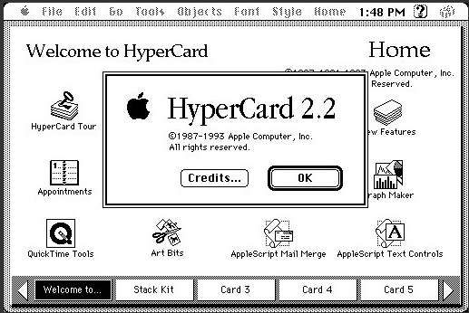
Hyperlinks
Macintosh 1984
Introduced an application called “HyperCard”
People didn’t understand it and deleted it
World Wide Web 1991
People became aware of Web Pages & the Internet
Hyperlinks are the fundamental technology behind Web Pages

